Slide 1
ANOMALY DETECTION
- By Raybhan Pawar

Slide 2
An Overview of the data
The dataset consists of 42070 rows and 84 columns.
16 columns (timestamp, input current, Heat Sink Temp, Engineering Sensors 1 – 13 ) have been used in the project for the purpose of Anomaly Detection.
The sensor readings are captured at an interval of 10 seconds.
The dataset consists of sensor readings captured for 6 days – 21/Sept/2014 and from 6/Aug/2017 to 10/Aug/2017.

Slide 3
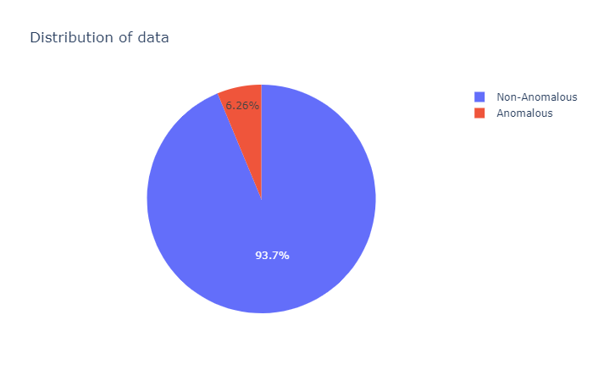
Overall Data Distribution
6.26% of the captured sensor readings have been detected as anomalous.
93.74% of the captured readings are non-anomalous

Slide 4
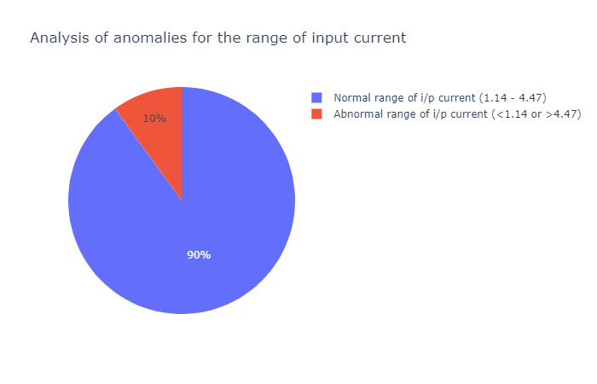
Anomalous Data Distribution
It has been found out that when the readings were non anomalous, the input current range was 1.14 - 4.47 whereas when the readings were anomalous, the input current range was 1.05 – 7.28.
Just 10% of the total anomalies were detected when the input current was not in the normal range (1.14 – 4.47).
Also, it can be inferred that whenever the input current is below 1.14 or 4.47 then the captured reading would be anomalous.

Slide 5
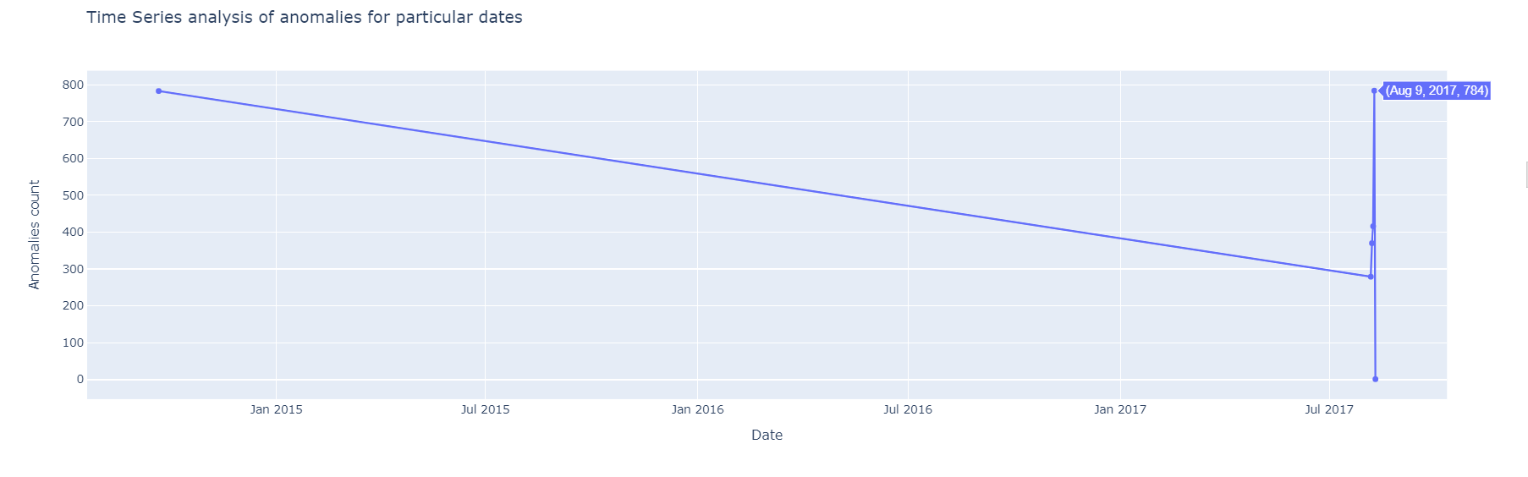
Time Series Analysis of anomalies
The number of anomalies detected on 21st Sept 2014 were far greater than that detected during the initial days of August 2017.

Slide 6
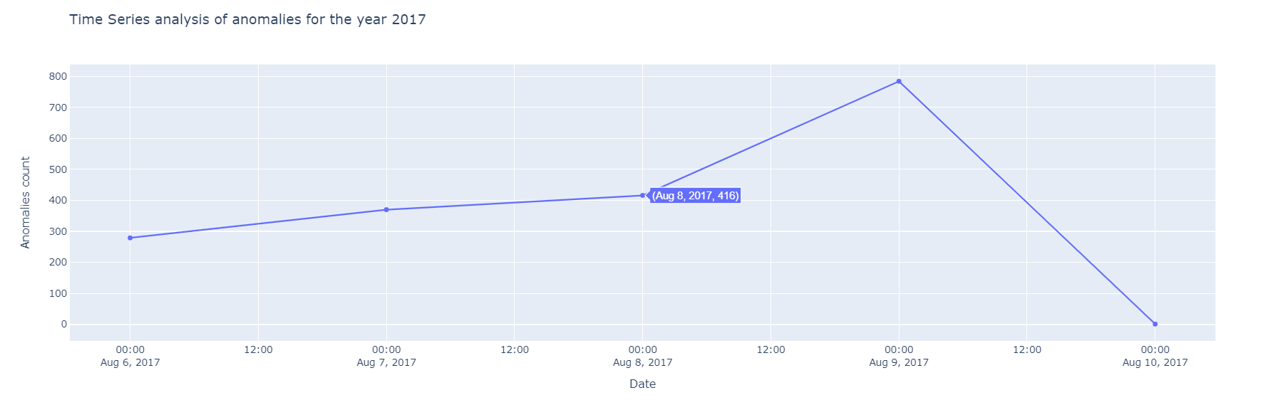
Time Series Analysis of anomalies for the year 2017
The number of anomalies kept on increasing from 6th to 9th August whereas it reached an all time low on 10th August 2017.

Slide 7
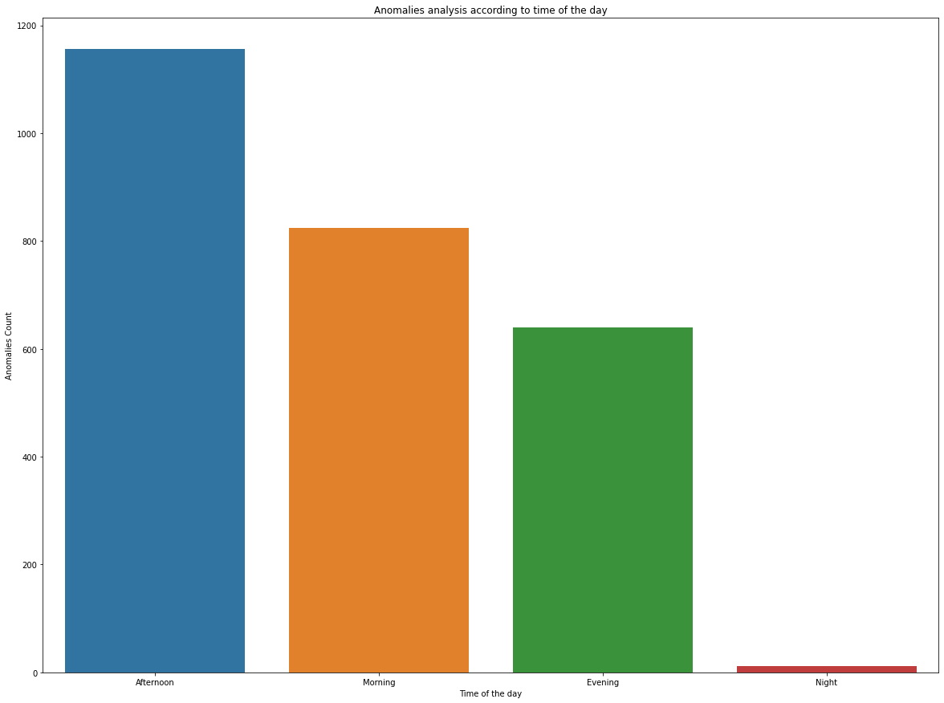
Anomaly Analysis according to the time of the day
Most of the anomalies in sensor readings occurred during the afternoon period i.e. 12:00 pm to 4:59 pm.
The least number of anomalies occur during the night time i.e. during 8:00 pm to 5:59 am.

Slide 8
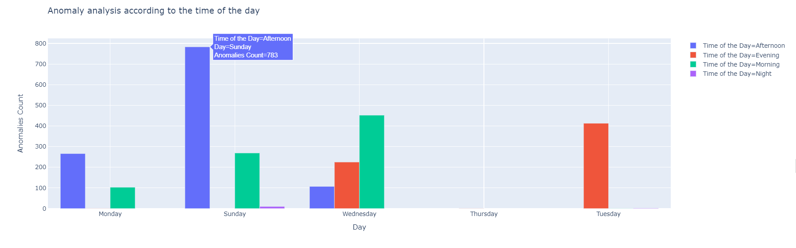
Anomaly Analysis according to the time of the day for particular days
Sunday afternoon (i.e. between 12:00 pm to 4:59 pm) recorded the highest number of anomalies (783).

Slide 9
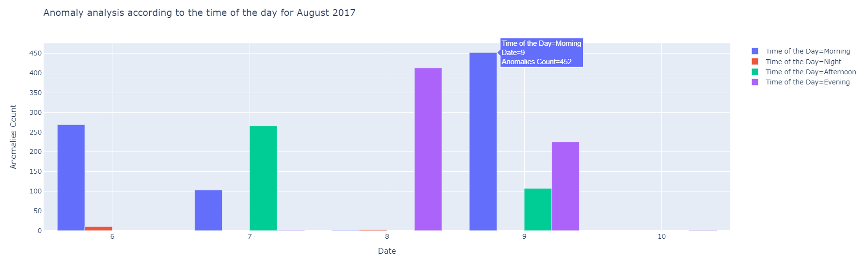
Anomaly Analysis according to the time of the day for August 2017
During the 5 days of August most of the anomalies were recorded during the morning period i.e. between 6:00 am to 11:59 am.

Slide 10
Machine Learning
Machine learning models used for predicting anomalies after labelling the data
K Means Clustering
Decision Tree Classifier
Random Forest Classifier
XGBoost Classifier
Metrics Used for model evaluation
F1 score
RMSE
Accuracy
The Random Forest Classifier model had a better performance amongst others.

Slide 11
Following features were selected which gave the best model performance for RandomForestClassifier
input current
Heat Sink Temp
Engineering Sensors 1
Engineering Sensors 2
Engineering Sensors 3
Engineering Sensors 4
Engineering Sensors 6
Engineering Sensors 7
Engineering Sensors 8
Engineering Sensors 9
Engineering Sensors 10
Engineering Sensors 11
Engineering Sensors 12
Engineering Sensors 13
Hour
Minutes
August
(The subset of the original given dataset consisted of 16 features. Thirteen new features were created while feature engineering resulting in a total of 29 features in the dataset)

Slide 12
RandomForestClassifier Model Performance Achieved
F1 Score | RMSE | Accuracy
0.9557 | 0.0739 | 0.9945

Slide 13
Reasons for Feature Selection
A combination of Correlation score and Feature Importance was used for selecting the features.
For instance
Of the newly created features, ‘Hour’, ‘Minutes’ and ‘August’ were selected because they had significant feature importance for the model.
10 out of 14 of the newly created features were dropped because they had a low feature importance for the model. ‘Date’ was dropped because it was redundant.
The ‘Engineering Sensors 5’ was dropped because it had a low correlation with the target variable.
‘Heat Sink Temp’ and ‘input current’ amongst others had a greater correlation with the target variable.

Slide 14
THANK YOU!

